Slide 1

System for smart common sports grounds management
Capstone project - phase 1
Advisor: Dr. Zeev Frankel
Obied Haddad - 206989295
Ebrahem Enbtawe - 208047357
Notes:
Hi Everyone, Thank you for being here today. We are excited to present our “System for smart common sports grounds management” me Obied and my partner Ebrahem, under the guidance of our advisor Dr.Zeev Frankel

Slide 2
Table of contents
01
02
03
04
05
Introduction
The problem
The solution
Project Architecture
Tests
Notes:
Here is what we are going to talk about today,
first we will introduce our project,
next we will present the problem,
after that we will explain our solution,
then we will go over the project structure,
finally we will show the tests we did to make sure our solution works.

Slide 3
01
Introduction

Slide 4
Introduction
Field Booking
Reservation Efficiency
Centralized Hub
the field reservation app is a fundamental tool for any individual seeking to book sports fields.
sport enthusiasts prefer reservation apps over manual logistics by utilizing the service of an external app
This app serves as a central hub for users to search, compare, and book available fields based on their specific needs and preferences
Notes:
This is where we introduce our app and what it's all about.
Our app is all about booking sports fields. It's like a super important tool for anyone who wants to play sports.
Instead of dealing with the trouble of deciding when and where to play, people can use our app to make reservations easily.
Think of our app like a big meeting place for sports lovers. You can look for fields, compare them, and book the one that suits you best, all in one place.

Slide 5

The Problem
Double-Bookings and Conflicts
Overwhelmed Users with Too Many Options
Lack of Engagement and Personalization
The difficulties that fields managers face in managing their fields
Notes:
Users often face issues like:
1.double bookings: Sometimes,different users try to book the same filed at the same time which will lead to a conflict.
2.too many choices that can be confusing: There are often so many fields to choose from that it becomes confusing.
3.and a lack of personalized options: Other apps don't give personalized suggestions based on what users like or have booked before, which makes it tough for them to find the perfect sports field to book.
On the other hand,
Field managers struggle with:
1.efficiently managing reservations,
2.and avoiding scheduling conflicts.
Managers needs a better way to handle bookings and keep track of field availability.
These problems show that we need a solution to help both users and managers.

Slide 6
Current State
Today, many Apps are solving one of the problems mentioned before.
No solution includes a solution for all the problems.
Notes:
Right now, there are a lot of apps that help book sports fields,
but none of them solve all the problems
This gap in the market means our app has a big opportunity to handle these different problems at once
and offer a better solution for users and managers.

Slide 7

Our Solution
Managers can easily manage their reservations/fields
App that includes Friendly GUI and different features to enhance user experience
Win Win For both Users!
Notes:
Our solution offers a user-friendly app that enhances the user experience with a friendly GUI and various features.
Managers can easily manage their reservations and fields, creating a win-win situation for both users and managers.

Slide 8



Technologys
Backend
Frontend
Flask-SQLAlchemy
Lightweight web framework with ORM.
Flutter
UI toolkit for building cross-platform apps.
Database
PostgreSQL
Reliable and performant relational database.
Notes:
Let's take a look at the technologies we will use to build our app.
For the backend:
we use Flask-SQLAlchemy, a lightweight web framework with an ORM
Object-Relational Mapping, is a tool that helps us manage our database by letting us work with objects in our code instead of directly dealing with the database tables,
and PostgreSQL for Data Storage, and relational database which is really reliable and fast when it comes to storing and retrieving data.
On the frontend:
we use Flutter, a UI toolkit for building cross-platform apps.
These tools make sure our app is strong and can handle lots of users without any issues.

Slide 9

Algorithm
Preventing double reservations
Upon receiving a reservation request, the system checks the availability of the requested field for the specified date and time.
If the requested time slot is already booked or conflicts with an existing reservation, the system initiates an automated conflict resolution process.
If the requested time slot is available, the reservation is confirmed, and the system updates the field's booking schedule accordingly.
Notes:
This algorithm helps us stop double bookings, so people don't accidentally reserve the same field at the same time.
We want to make sure that when someone wants to book a field, they don't accidentally book a time slot that's already taken.
1.When someone wants to reserve a field, the system first checks if that time slot is available.
If it's free, the reservation is confirmed, and the system updates the booking schedule accordingly.
2.However, if the time slot is already booked or there's a conflict with an existing reservation, the system automatically starts a process to resolve the conflict.
3.This conflict resolution process considers things like how important the reservation is, how close the user is to the field, and what the user's preferences are.
4.Based on all these factors, the system selects the best way to sort out the conflict. This might involve suggesting different times.
5.Once the system figures out the best solution, it lets everyone involved know what's happening and updates the reservation status accordingly.

Slide 10
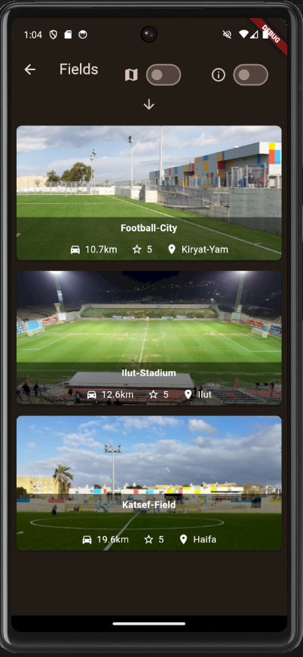
Algorithm
Best available field selection
The algorithm selects the best available field for each reservation based on certain criteria, such as proximity, field availability, field ratings.
Formulas:
proximity_score=1/distance(customer.location,field.location)
ratings_score=1/(1+exp(−average_rating(field.user_ratings)))​
Notes:
Thank you Obied, Hello everyone as obied mentioned I am ebrahem and I am going to continue to talk about other algorithms that we used in our APP, Sigmoid Function, why is it good? 1. Normalizing keeping the result between 0 - 1
2. We will prevent sudden spikes in ratings Field availability - if the field is not available it will not be included from the beginning These two parameters will decide how much does a field matches the customer’s specifications

Slide 11
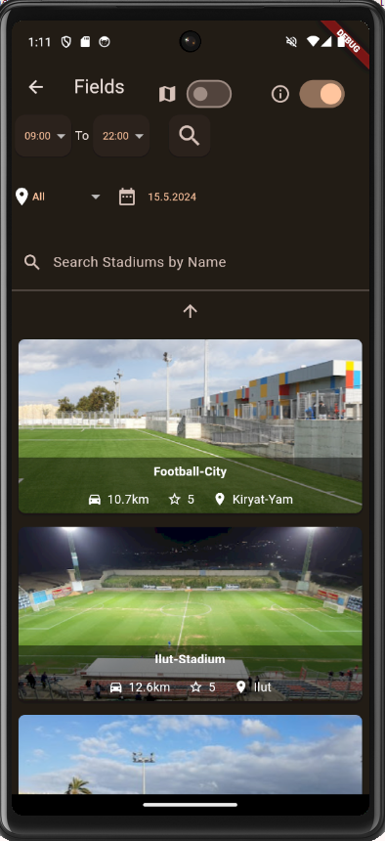
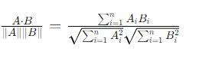
Algorithm
Filtration
Our filtering system streamlines the search for specific fields, ensuring users find what they need efficiently.
Cosine Similarity Formula
1. Represent user’s preferences (1. filtering result, 2. predefined user preference) as vectors.
2. The fields will be sorted according to which of the field vectors are more similar to the predefined user preference vector)
3. Display sorted filtered fields
Notes:
Our filtering system will ensure that the customers always find what they need efficiently Why use cosine? 1. Can handle large datasets
2. Normalization which will help compare on the same scale
Why does it range between -1 and 1
Its because it generates a vector which can be 1 meaning as much similarity and -1 the maximum disamilirity

Slide 12
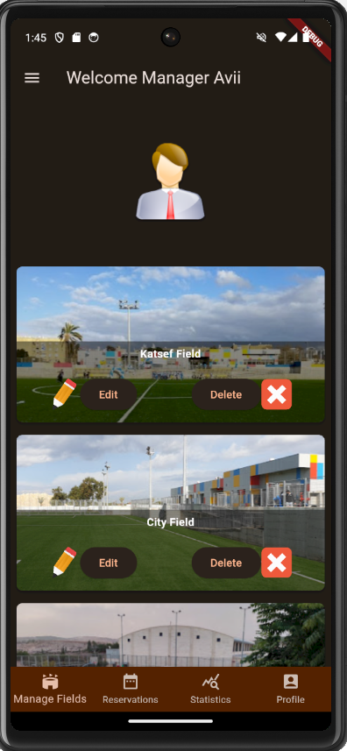
Side of Manager:
Edit field parameters.
Manage reservations.
View statistics.
Optimization.
Notes:
Here we can see the Manager side of the app and the different features he has
Explain a little about the GUI

Slide 13
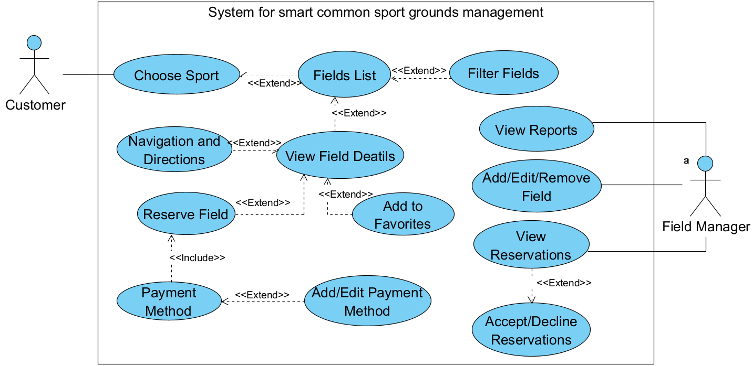
Use Case
Notes:
Main points: How many entities
Little explanation of the features of each entity

Slide 14
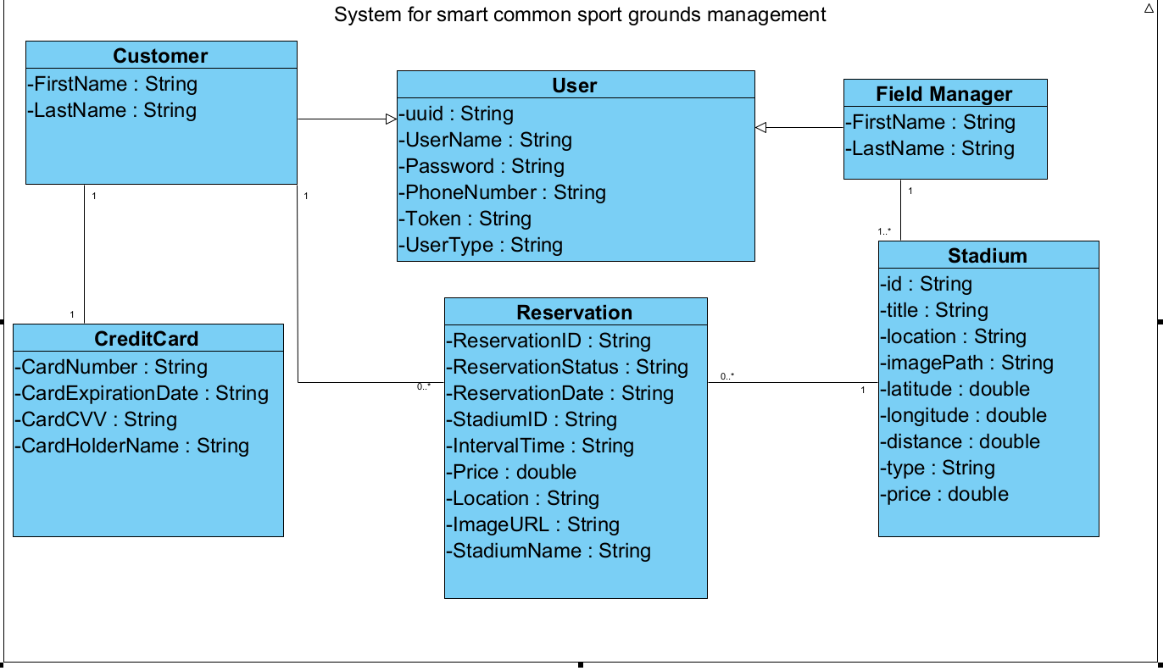
Class Diagram
Notes:
Mention the main entities, from where they inherit?

Slide 15
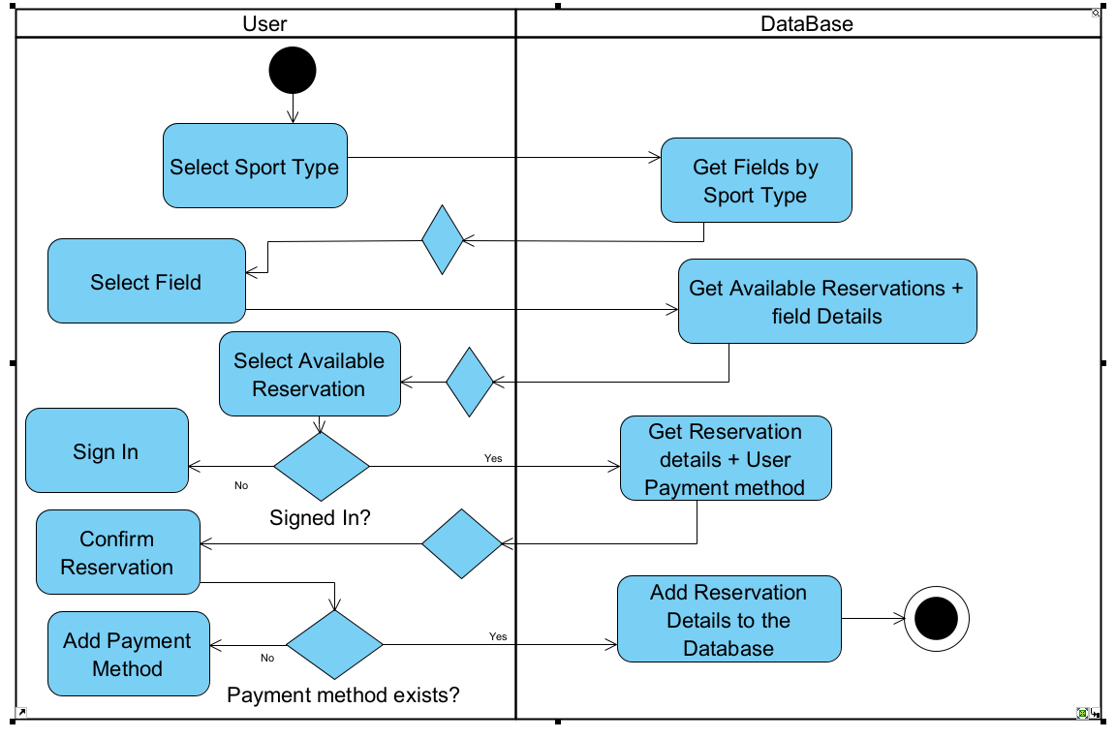
Activity Diagram
Notes:
No need to mention every step of the flow

Slide 16
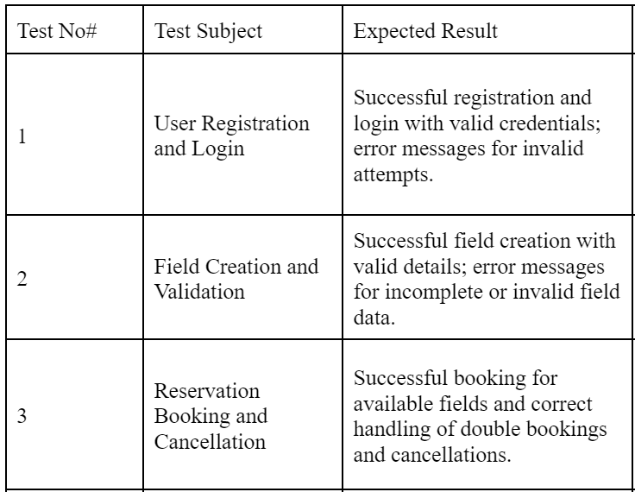

Unit Tests
Notes:
Give example of two unit tests

Slide 17
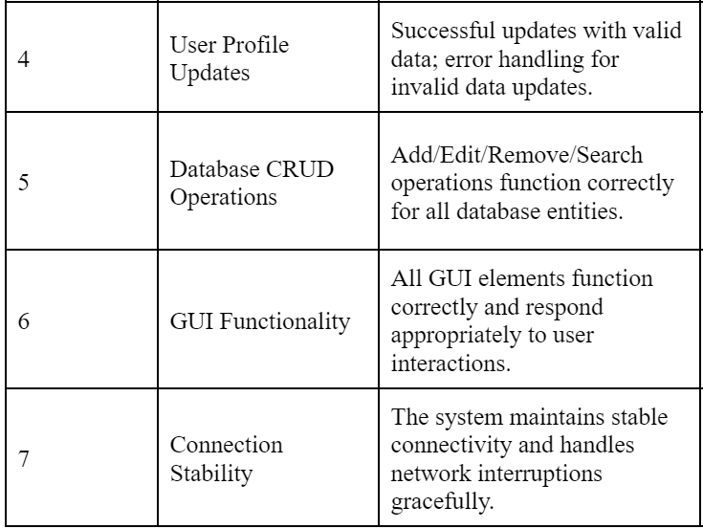
Unit Tests
Notes:
Same as before

Slide 18
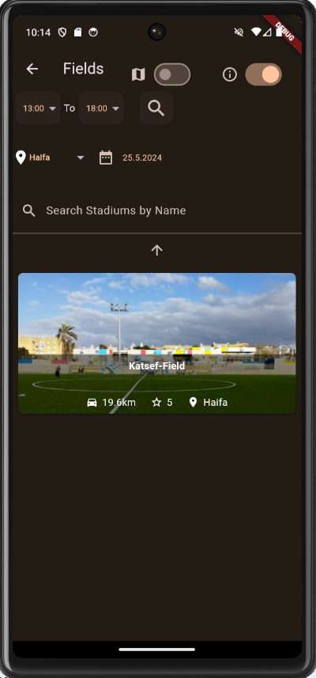
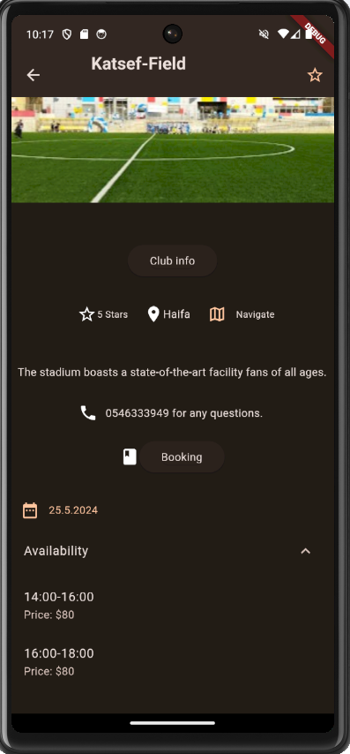
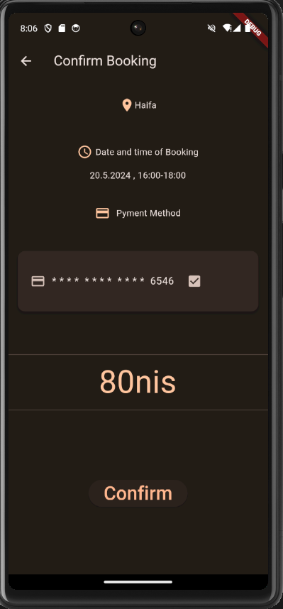
Reserve Field Flow - Customer
Choosing the field according to specific requirements
Selecting Available time
Confirm Booking
Notes:
Quick review of the reserve field flow with GUI

Slide 19
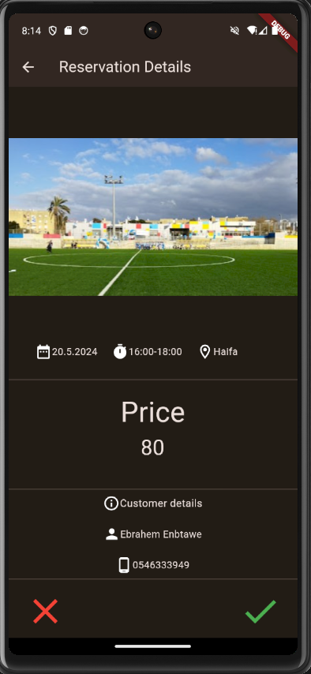
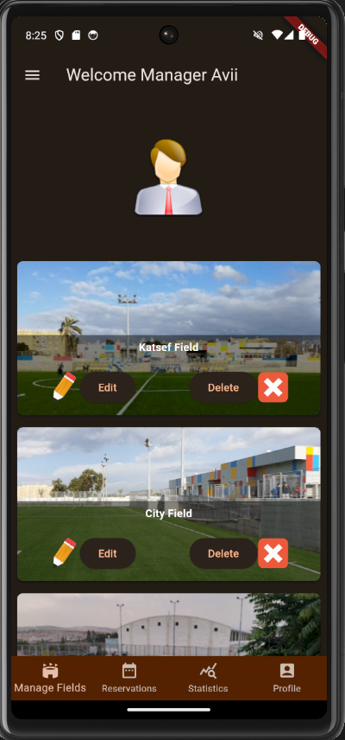
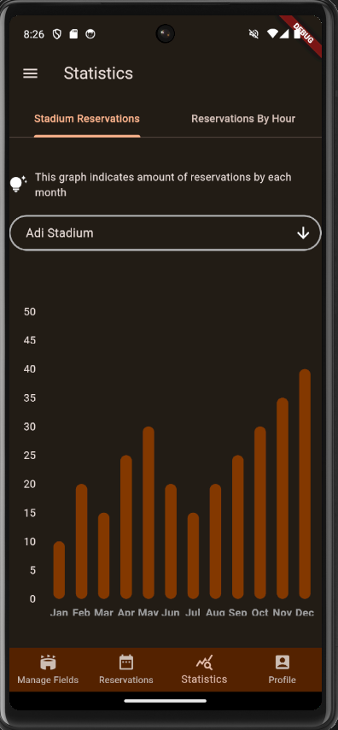
Manager Side
Manager can accept/deny reservation
Manager can edit/Delete their fields
Manager can view their field statistics
Notes:
Manager side GUI

Slide 20
